Slide 1
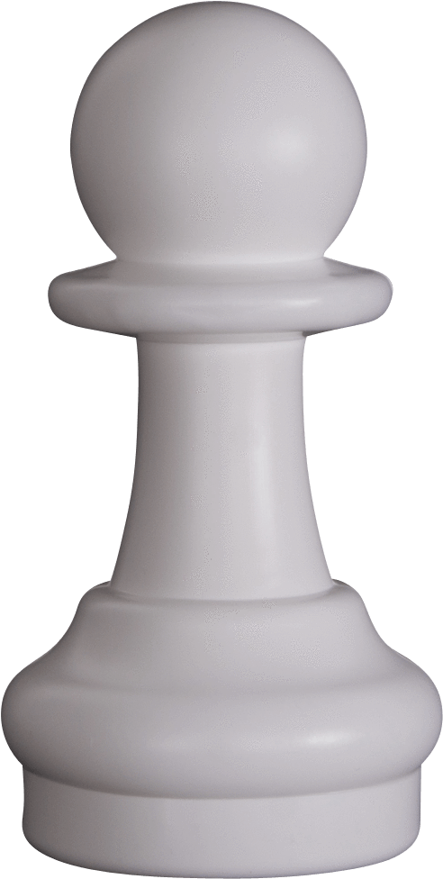
ChessApp
Brian Ouzomgi
CMPSC 475 Final Project

Slide 2
What is ChessApp?
Play Local Games with friends
Review games played
Customize your experience
Demo!

Slide 3
Design Process
Inspiration
2 rounds of feedback
Scenario Testing
Game ends by time without any moves played?
Checkmate by pawn promotion?
Checkmate by castling? Castle through check?
Stalemate? 3 Move repetition? Insufficient material?
Game review with no games played?

Slide 4
Design Implementation
Two models: EngineModel & SettingsModel
One view model
Much of temporal behavior is in views
Reusing Views
Chess Boards, Pickers
Class Extensions
Custom Colors, date formatting
Constants File
Comments

Slide 5
Design Implementation Cont.
Single Source of Data
Many computed properties
Current side, text for times, tile colorization
Stored games are just notation, player names, & times
Proper coding techniques
Repetition:
Line following pieces overlap
Bishop + Rook = queen
Move calculation -> King in danger?

Slide 6
How intelligent is ChessApp?
Checkmate by time
Stalemate, 3 move repetition, draw by insufficient material
Both kingside and queenside castling
Double-step pawns
Pawn promotion
Checkmate by capture
Checks avoidance by capturing attacker, moving, or blocking

Slide 7
Struggles
Overcame
Alerts not showing
Sound players not playing
Spacings on the app, file & rank notations
Core data & custom data types
Pivoted
Changing Chess piece styles
Opening detector API
Capturing + promoting

